Slide 1
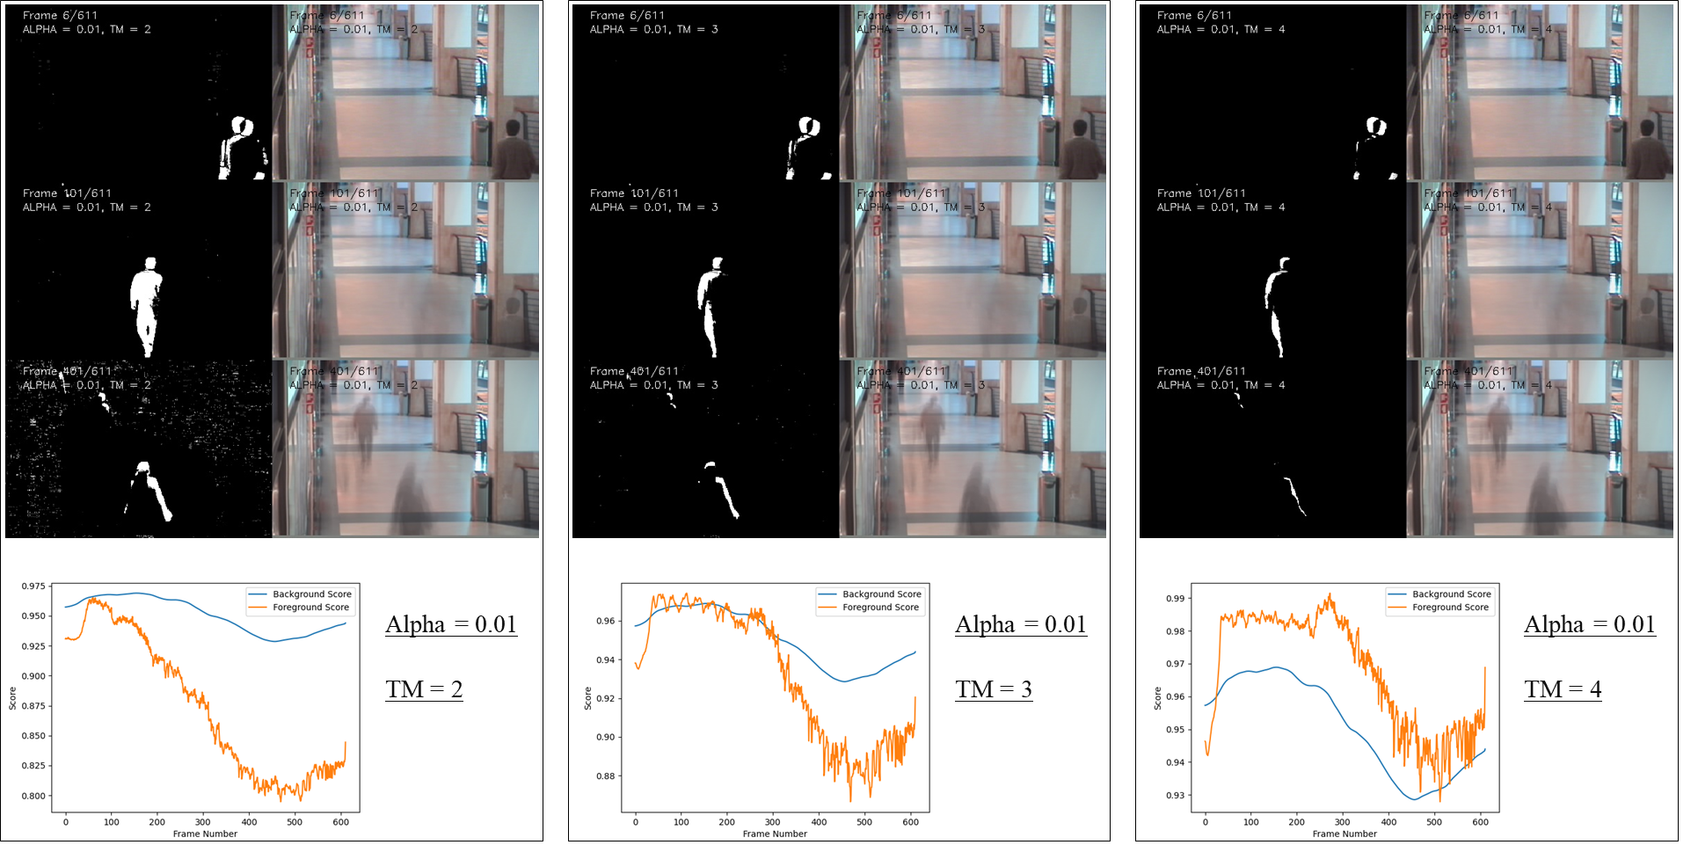
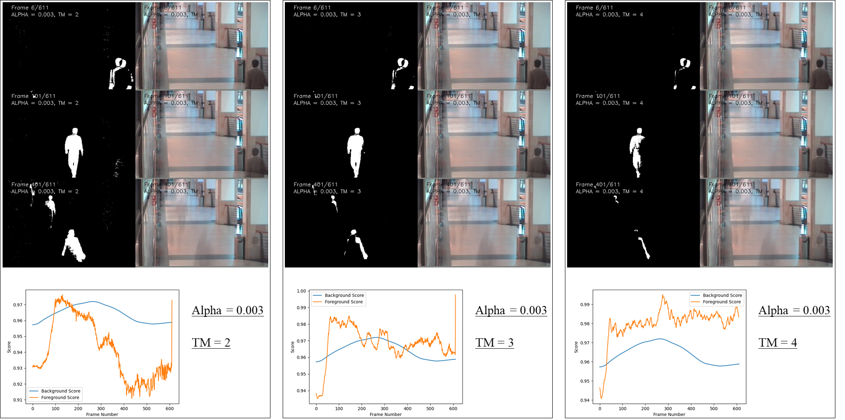
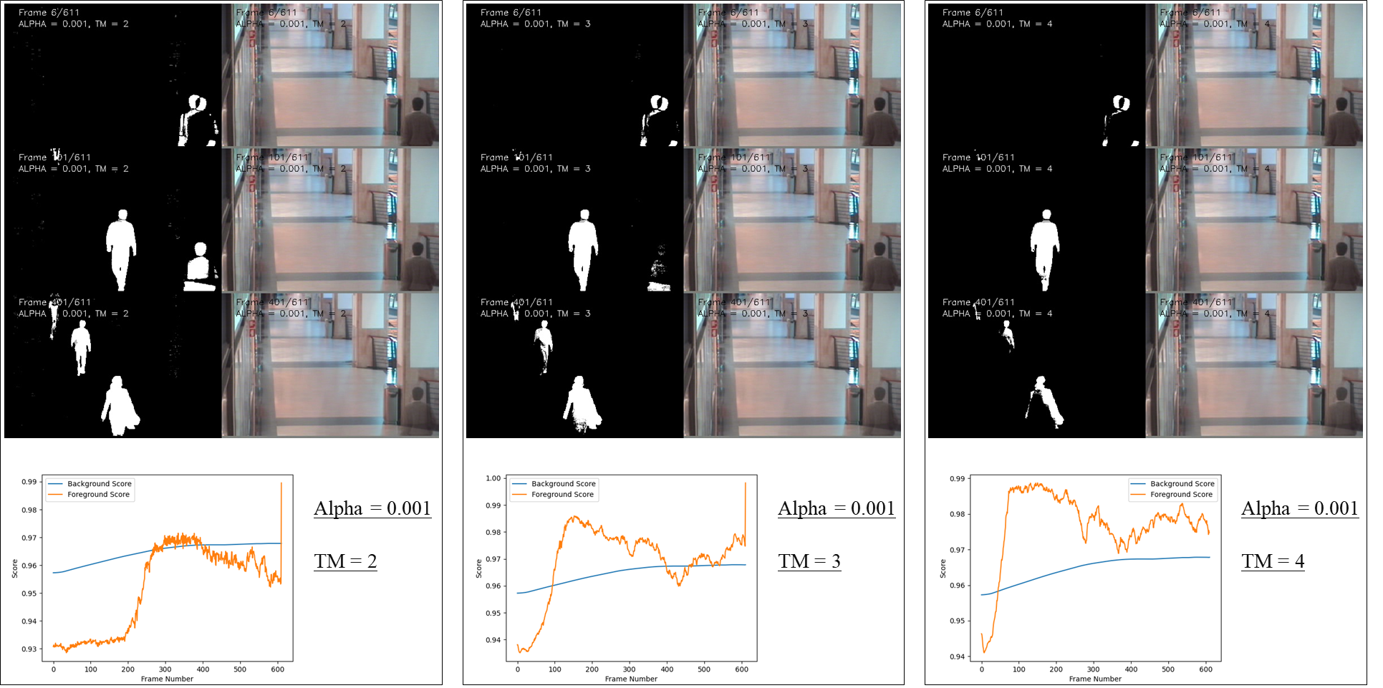


HOMEWORK 4B
ECE/CS 8690 2302 Computer Vision
Alpha = 0.01
①
$$Moving Object Detection using$$
$$Simple Background Subtraction$$
Xuanbo Miao
14422044
xmiao@mail.missouri.edu
Alpha = 0.003
②
Abstract
This assignment focuses on implementing a basic pipeline for feature detection, description, and matching. The first step is feature detection, which involves computing the autocorrelation matrix and a scalar feature detection measure using a formula discussed in class. The detected feature points are then shown in the image and included in the report. The second step is feature matching and evaluation, which involves defining and describing a feature descriptor and using it to match features using three different strategies. The performance of the feature matching is evaluated using transformation/homography matrices provided with the data.
Alpha = 0.001
③

Slide 2
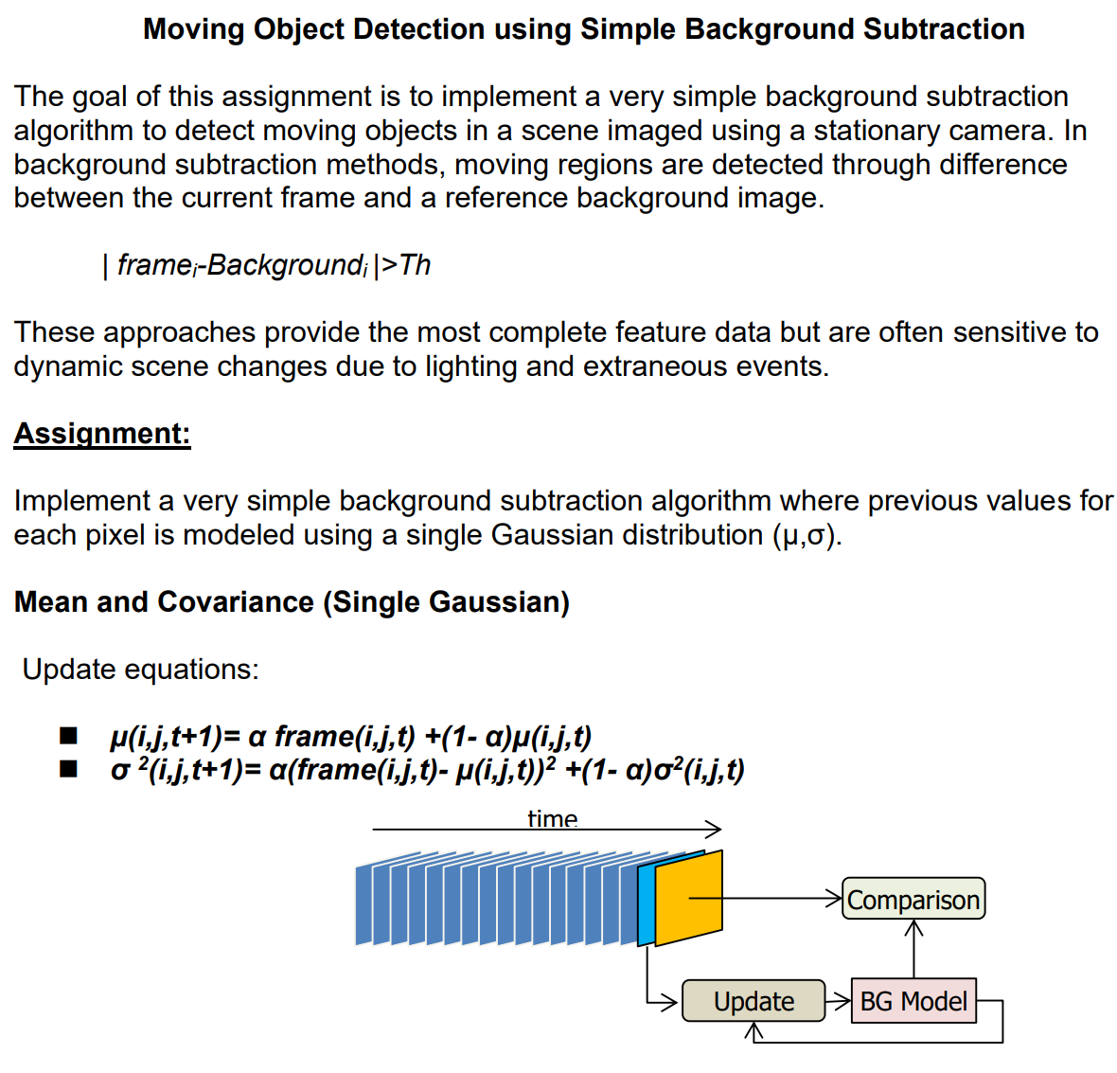
Introduction
In the field of computer vision, detecting and tracking moving objects in video streams is a crucial task with numerous applications, including surveillance, traffic monitoring, and robotic navigation. One popular technique for accomplishing this is through background subtraction, where the objective is to identify the foreground, consisting of moving objects, by distinguishing it from the static background.
In this assignment, we will implement a simple background subtraction algorithm using a single Gaussian model for each pixel to detect moving objects in a video sequence captured by a stationary camera. The algorithm involves maintaining a background model, classifying pixels as foreground or background based on their differences from the background model, and updating the background model with new frames over time.
We will experiment with different learning rates and matching thresholds to analyze the performance of the algorithm in detecting moving objects. The test data for this assignment is taken from the CAVIAR1 dataset, and the results will be evaluated using frames 5, 100, and 400. The assignment will be assessed on the basis of the source code, visualizations, and interpretations of the results.

Slide 3
Codes as required
def main():
if not os.path.isdir(OUTPUT_PATH):
os.mkdir(OUTPUT_PATH)
flist = [f for f in os.listdir(INPUT_PATH) if f.endswith('.png')]
flist = sorted(flist)
n = len(flist)
true_bg = cv2.imread(BG_true_PATH)
for ALPHA in ALPHA_list:
for TM in TM_list:
# print the parameters
print(f'ALPHA = {ALPHA}, TM = {TM}')
# Read the first image and initialize the model
im = cv2.imread(os.path.join(INPUT_PATH, flist[0]))
bg_model = BGSubModel(im, ALPHA, TM, true_bg)
# Set up the VideoWriter objects
# the name should contain the parameters of the model, ALPHA and TM
fourcc = cv2.VideoWriter_fourcc(*'XVID')
video_file = os.path.join(
OUTPUT_PATH, f'{ALPHA}_{TM}.avi')
video_writer = cv2.VideoWriter(
video_file, fourcc, 10, (im.shape[1]*3, im.shape[0]))
bg_scores = []
fg_scores = []
# Main loop
for fr in range(n):
# Read the image
im = cv2.imread(os.path.join(INPUT_PATH, flist[fr]))
# Classify the foreground using the model & Update the model with the new image
fg_mask = bg_model.classify(im)
bg_model.update(im)
# Display the input frame, background model, and foreground mask
im_draw = im.copy()
cv2.putText(im_draw, f'Frame {fr+1}/{n}', (im.shape[1]//15, 20),
cv2.FONT_HERSHEY_SIMPLEX, 0.5, (0, 0, 0), 1)
cv2.putText(im_draw, f'ALPHA = {ALPHA}, TM = {TM}', (im.shape[1]//15, 40),
cv2.FONT_HERSHEY_SIMPLEX, 0.5, (0, 0, 0), 1)
bg_draw = bg_model.mean.astype('uint8')
cv2.putText(bg_draw, f'Frame {fr+1}/{n}', (im.shape[1]//15, 20),
cv2.FONT_HERSHEY_SIMPLEX, 0.5, (0, 0, 0), 1)
cv2.putText(bg_draw, f'ALPHA = {ALPHA}, TM = {TM}', (im.shape[1]//15, 40),
cv2.FONT_HERSHEY_SIMPLEX, 0.5, (0, 0, 0), 1)
fg_draw = cv2.cvtColor(fg_mask, cv2.COLOR_BGR2GRAY)
cv2.putText(fg_draw, f'Frame {fr+1}/{n}', (im.shape[1]//15, 20),
cv2.FONT_HERSHEY_SIMPLEX, 0.5, (255, 255, 255), 1)
cv2.putText(fg_draw, f'ALPHA = {ALPHA}, TM = {TM}', (im.shape[1]//15, 40),
cv2.FONT_HERSHEY_SIMPLEX, 0.5, (255, 255, 255), 1)
cv2.imshow('Input Frame', im_draw)
cv2.imshow('Background Model', bg_draw)
cv2.imshow('Foreground Mask', fg_draw)
# Press 'q' to exit the loop
if cv2.waitKey(1) & 0xFF == ord('q'):
break
# Save the results for specific frames
if fr in [5, 100, 400]:
fname = f'FGmask_{ALPHA}_{TM}_{fr}.png'
fname_wpath = os.path.join(OUTPUT_PATH, fname)
cv2.imwrite(fname_wpath, fg_draw)
fname = f'BGmean_{ALPHA}_{TM}_{fr}.png'
fname_wpath = os.path.join(OUTPUT_PATH, fname)
cv2.imwrite(fname_wpath, bg_draw)
# Write the current frame and FGmask to the videos
frame = np.hstack(
(im_draw, bg_draw, cv2.cvtColor(fg_draw, cv2.COLOR_GRAY2BGR)))
video_writer.write(frame)
# Print the progress using the same line
score_bg, score_fg = bg_model.evaluate()
bg_scores.append(np.mean(score_bg))
fg_scores.append(np.mean(score_fg))
print(f'Frame: {fr}/{n}, bg%: {np.mean(score_bg):.5f}, fg%: {np.mean(score_fg):.5f}', end='\r')
# conbine these eix images into one image
frame_numbers = [5, 100, 400]
file_prefixes = ['FGmask', 'BGmean']
image = combine_images(
OUTPUT_PATH, ALPHA, TM, frame_numbers, file_prefixes)
fname = f'{ALPHA}_{TM}.jpg'
fname_wpath = os.path.join(OUTPUT_PATH, fname)
cv2.imwrite(fname_wpath, image)
cv2.destroyAllWindows()
video_writer.release()
cv2.destroyAllWindows()
# print the status
print(
f'Done, bg%: {np.mean(score_bg):.5f}, fg%: {np.mean(score_fg):.5f} \n')
plt.plot(range(0, fr + 1), bg_scores, label='Background Score')
plt.plot(range(0, fr + 1), fg_scores, label='Foreground Score')
plt.xlabel('Frame Number')
plt.ylabel('Score')
plt.legend()
plt.savefig(os.path.join(
OUTPUT_PATH, f'op_curve_{ALPHA}_{TM}.png'))
# then end this plt
plt.close()
if __name__ == '__main__':
main()
Running dialog:
class BGSubModel:
# The model is initialized with the first frame.
def __init__(self, first_frame, alpha, tm, true_bg):
self.mean = np.float32(first_frame)
self.var = np.ones_like(self.mean) * 128
self.alpha = alpha
self.tm = tm
self.true_bg = np.float32(true_bg)
# Classify the current frame as foreground or background
def classify(self, current_frame):
diff = np.abs(np.float32(current_frame) - self.mean)
self.fg_mask = np.where(
diff > (self.tm * np.sqrt(self.var)), 255, 0).astype(np.uint8)
diff_true = np.abs(np.float32(current_frame) - self.true_bg)
self.true_fg_mask = np.where(
diff_true > (self.tm * np.sqrt(self.var)), 255, 0).astype(np.uint8)
return self.fg_mask
def evaluate(self):
mse_bg = np.mean((self.true_bg - self.mean) ** 2)
max_val_bg = np.max((self.true_bg.max(), self.mean.max()))
score_bg = 1 - np.sqrt((mse_bg / (max_val_bg ** 2)))
mse_fg = np.mean((self.true_fg_mask - self.fg_mask) ** 2)
max_val_fg = np.max((self.true_fg_mask.max(), self.fg_mask.max()))
# considering fg is only a very small part of the image, so we add a scale factor to make the score more reasonable
factor = 100
score_fg = 1 - np.sqrt((mse_fg / (max_val_fg ** 2)))*factor
return score_bg, score_fg
# Update the model with the current frame
def update(self, current_frame):
inv_alpha = 1 - self.alpha
self.mean = inv_alpha * self.mean + \
self.alpha * np.float32(current_frame)
self.var = inv_alpha * self.var + \
self.alpha * (np.float32(current_frame) - self.mean) ** 2
ALPHA = 0.01, TM = 2
Done, bg%: 0.94395, fg%: 0.84446 0.84446
ALPHA = 0.01, TM = 3
Done, bg%: 0.94395, fg%: 0.92052 0.92052
ALPHA = 0.01, TM = 4
Done, bg%: 0.94395, fg%: 0.96885 0.96885
ALPHA = 0.01, TM = 5
Done, bg%: 0.94395, fg%: 0.99053 0.99053
ALPHA = 0.01, TM = 6
Done, bg%: 0.94395, fg%: 0.99669 0.99669
ALPHA = 0.003, TM = 2
Done, bg%: 0.95890, fg%: 0.97283 0.97283
ALPHA = 0.003, TM = 3
Done, bg%: 0.95890, fg%: 0.99760 0.99760
ALPHA = 0.003, TM = 4
Done, bg%: 0.95890, fg%: nan g%: nan
ALPHA = 0.003, TM = 5
Done, bg%: 0.95890, fg%: nan g%: nan9034
ALPHA = 0.003, TM = 6
Done, bg%: 0.95890, fg%: nan g%: nan9209
ALPHA = 0.001, TM = 2
Done, bg%: 0.96782, fg%: 0.98956 0.98956
ALPHA = 0.001, TM = 3
Done, bg%: 0.96782, fg%: 0.99823 0.99823
ALPHA = 0.001, TM = 4
Frame: 578/611, bg%: 0.96783, fg%: 0.97714
ALPHA = 0.01, TM = 2
Frame: 453/611, bg%: 0.92858, fg%: 0.81196
ALPHA = 0.0003, TM = 3
Done, bg%: 0.96294, fg%: 0.99392 0.99392
ALPHA = 0.0003, TM = 4
Done, bg%: 0.96294, fg%: nan g%: nan8552
ALPHA = 0.0001, TM = 2
Done, bg%: 0.95944, fg%: 0.93437 0.93437
ALPHA = 0.0001, TM = 3
Done, bg%: 0.95944, fg%: 0.95644 0.95644
ALPHA = 0.0001, TM = 4
Done, bg%: 0.95944, fg%: 0.99379 0.99379

Slide 4
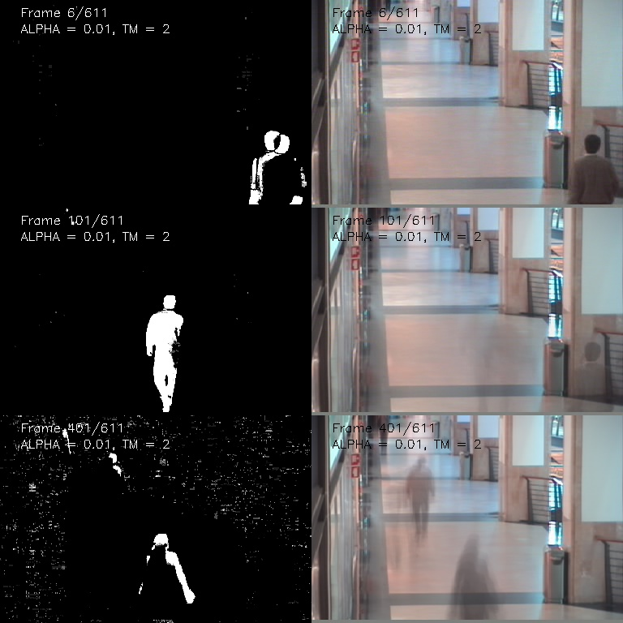
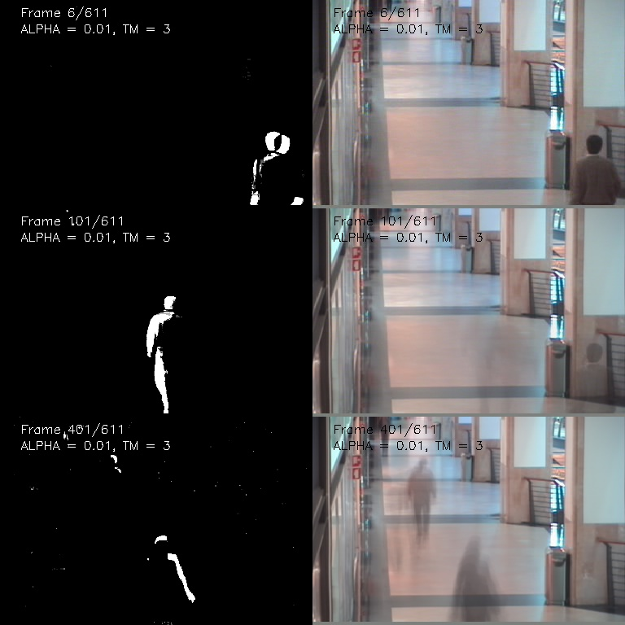
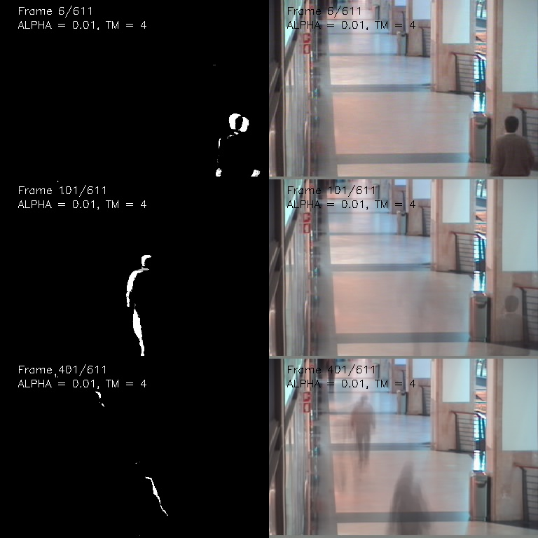
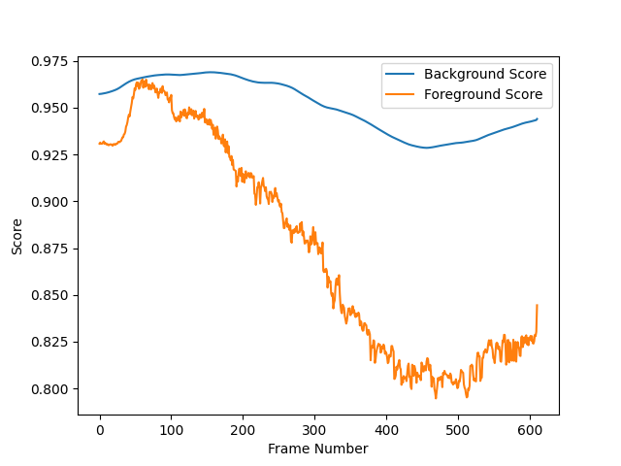
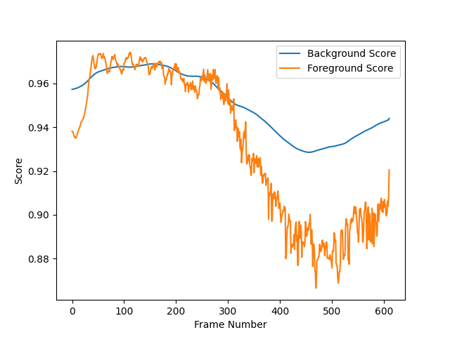
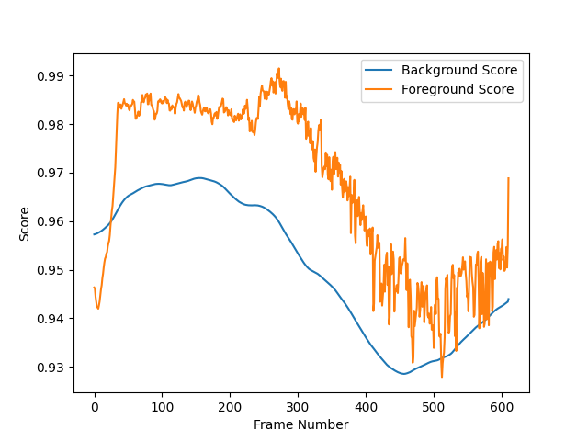
Results 1. Alpha = 0.01
Alpha = 0.01
TM = 2
Alpha = 0.01
TM = 3
Alpha = 0.01
TM = 4

Slide 5
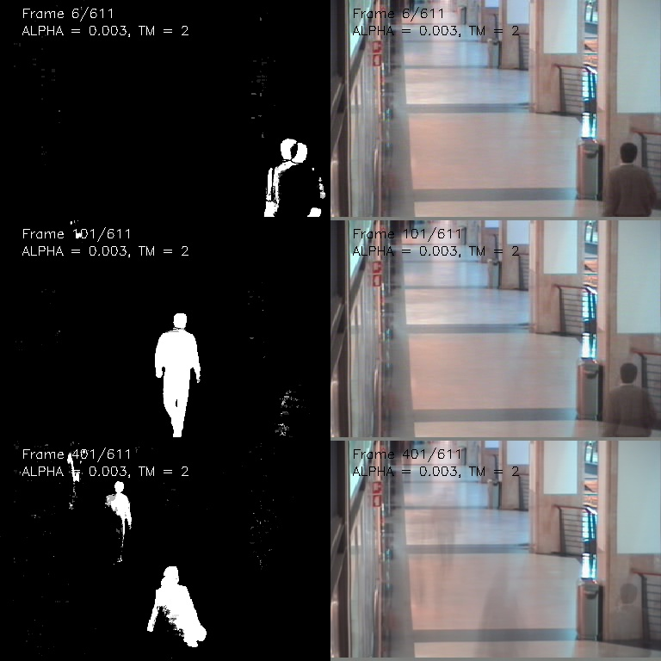
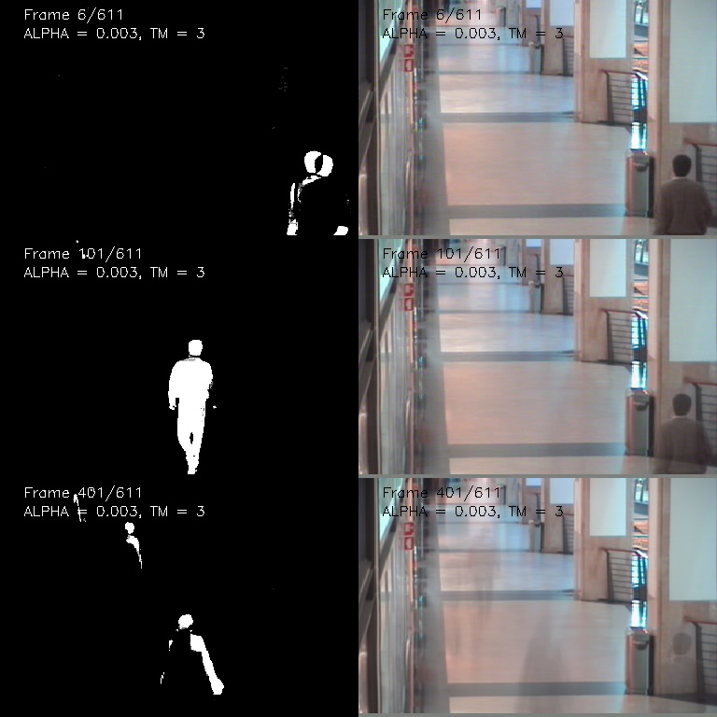
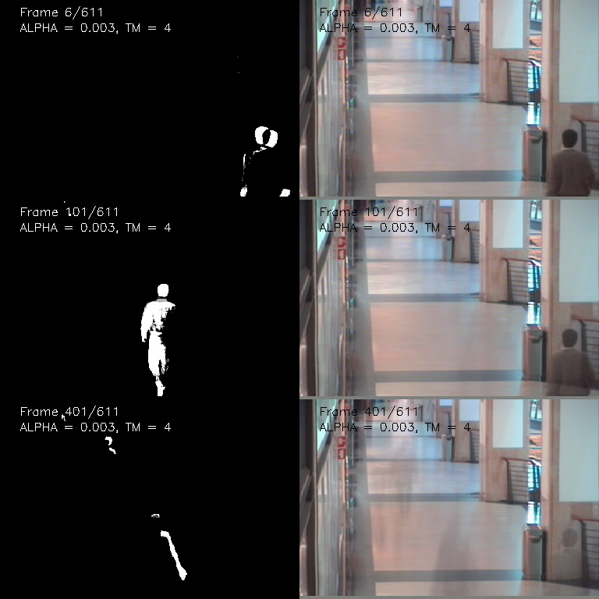
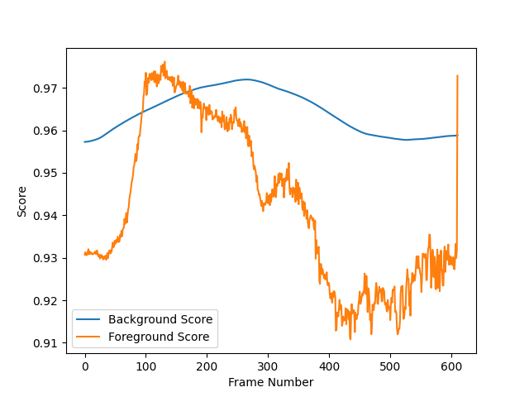
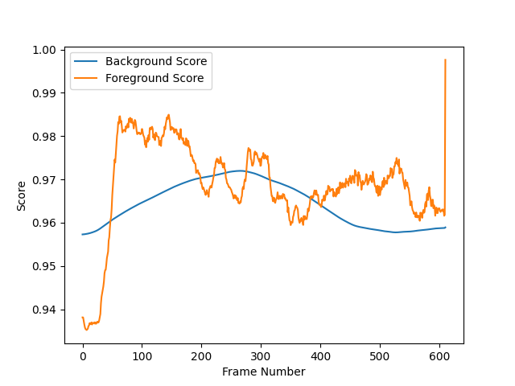
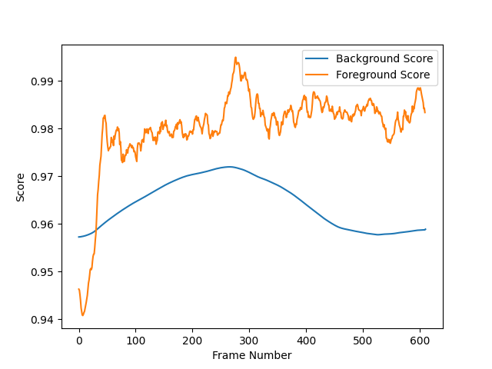
Results 2. Alpha = 0.003
Alpha = 0.003
TM = 2
Alpha = 0.003
TM = 3
Alpha = 0.003
TM = 4

Slide 6
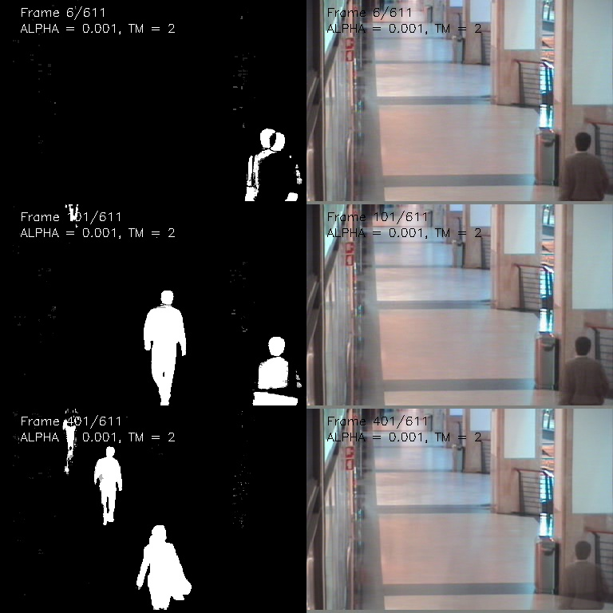
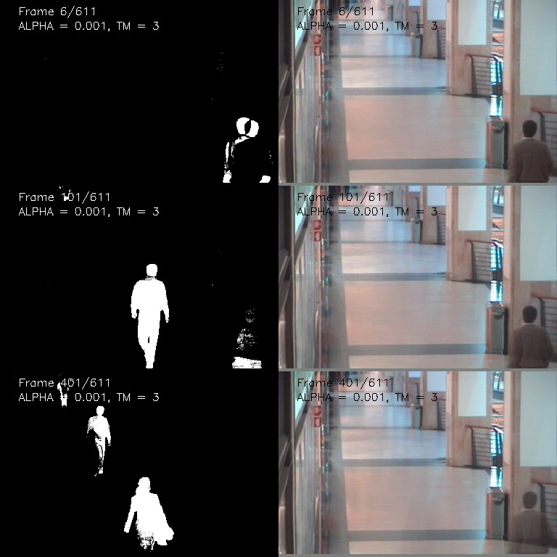
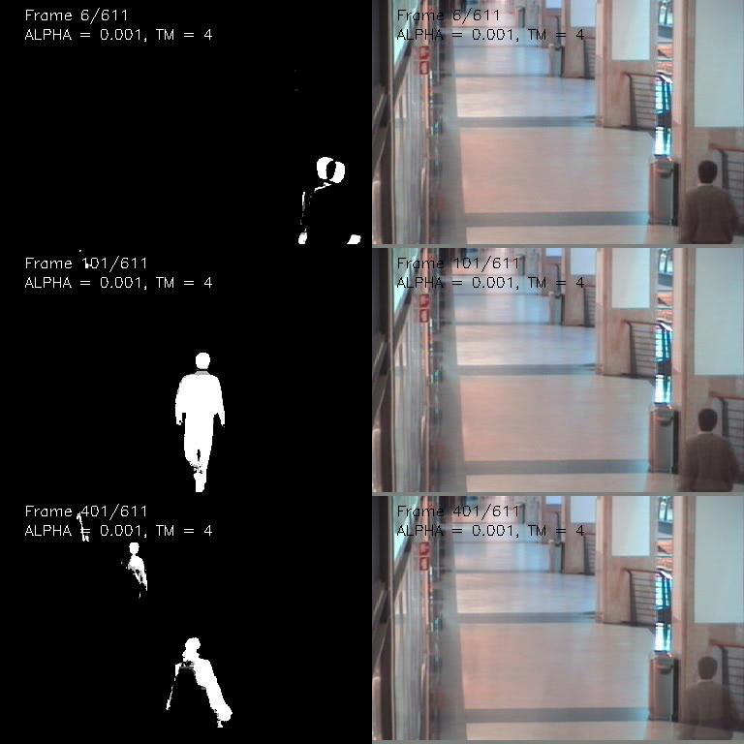
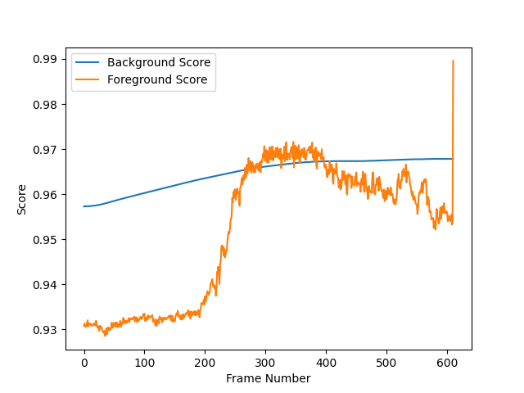
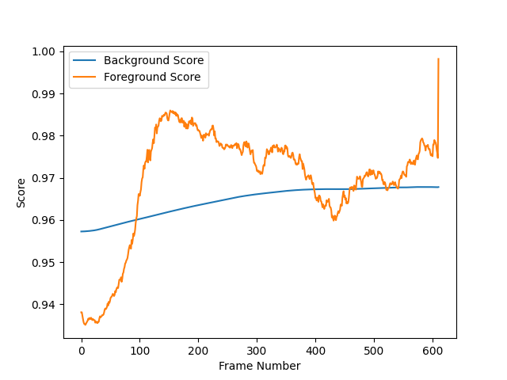
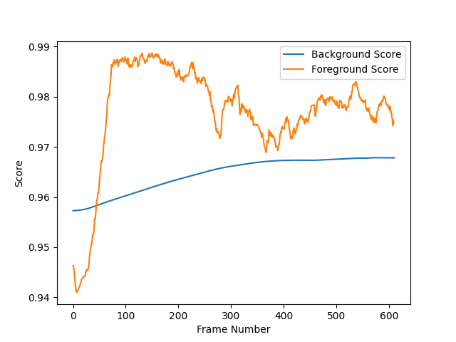
Results 3. Alpha = 0.001
Alpha = 0.001
TM = 2
Alpha = 0.001
TM = 3
Alpha = 0.001
TM = 4

Slide 7
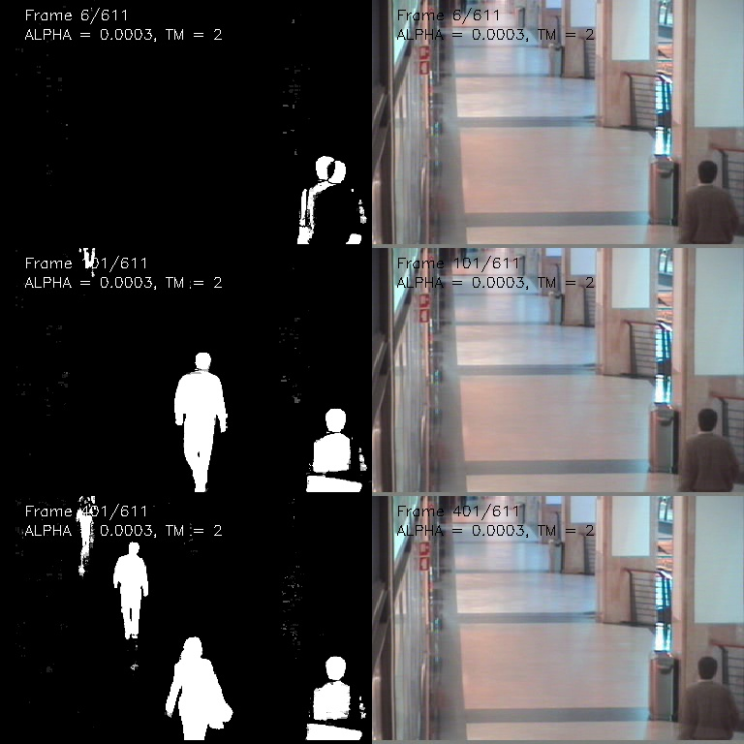
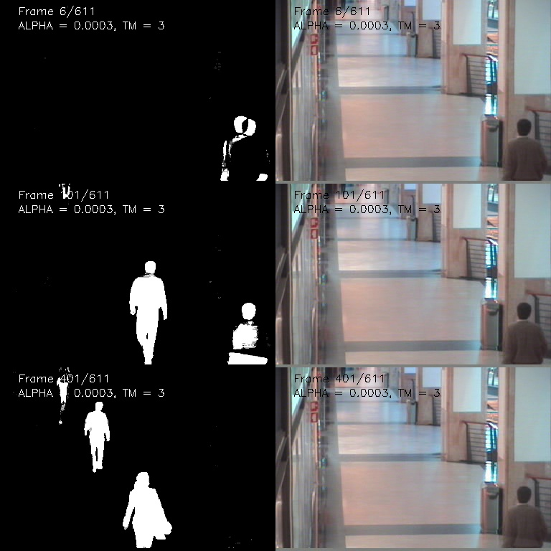
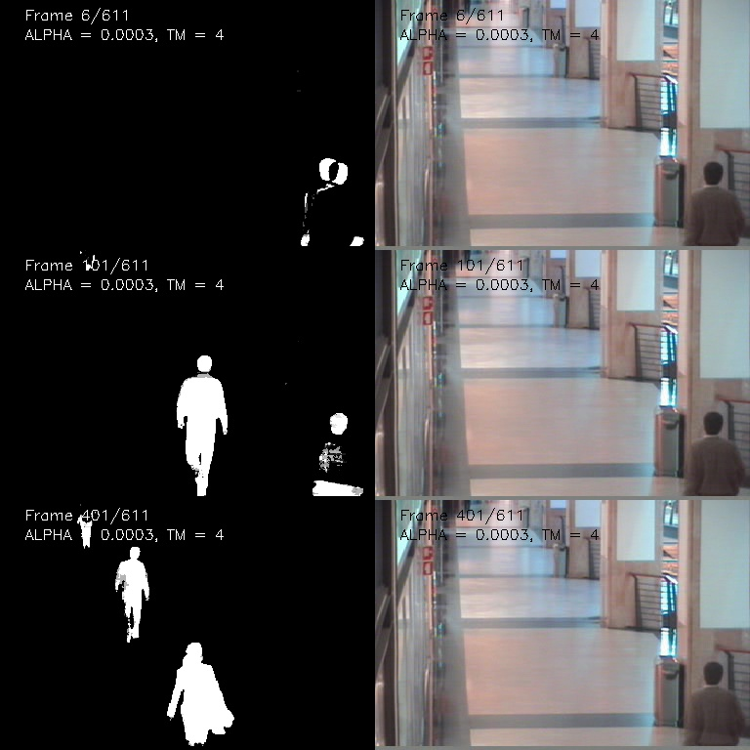
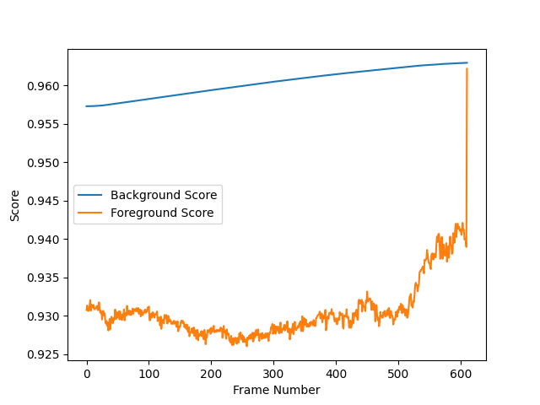
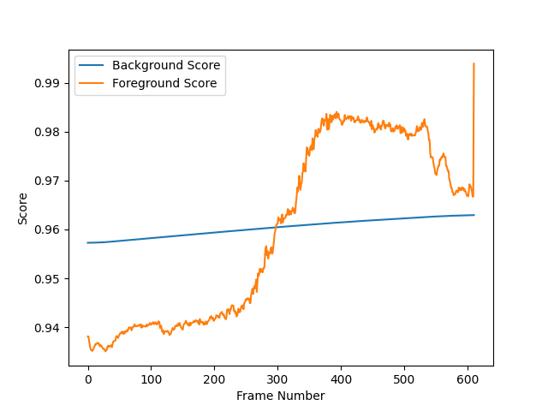
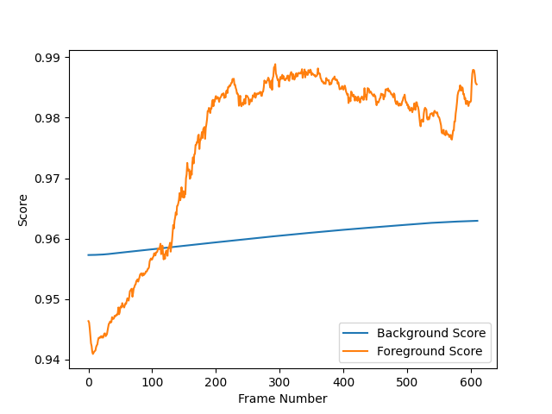
Results 4. Alpha = 0.0003
Alpha = 0.0003
TM = 2
Alpha = 0.0003
TM = 3
Alpha = 0.0003
TM = 4

Slide 8
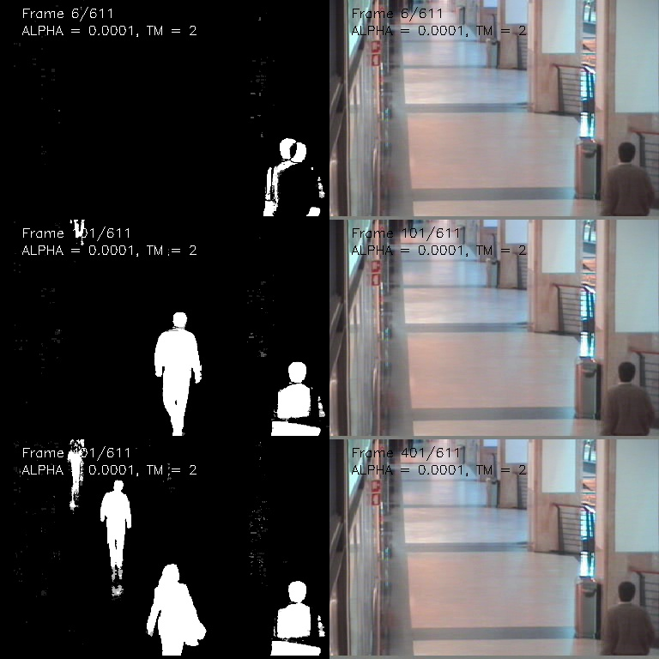
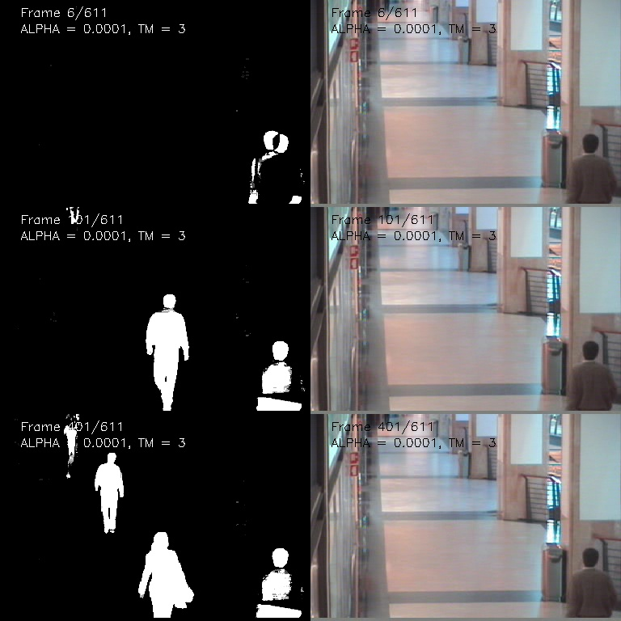
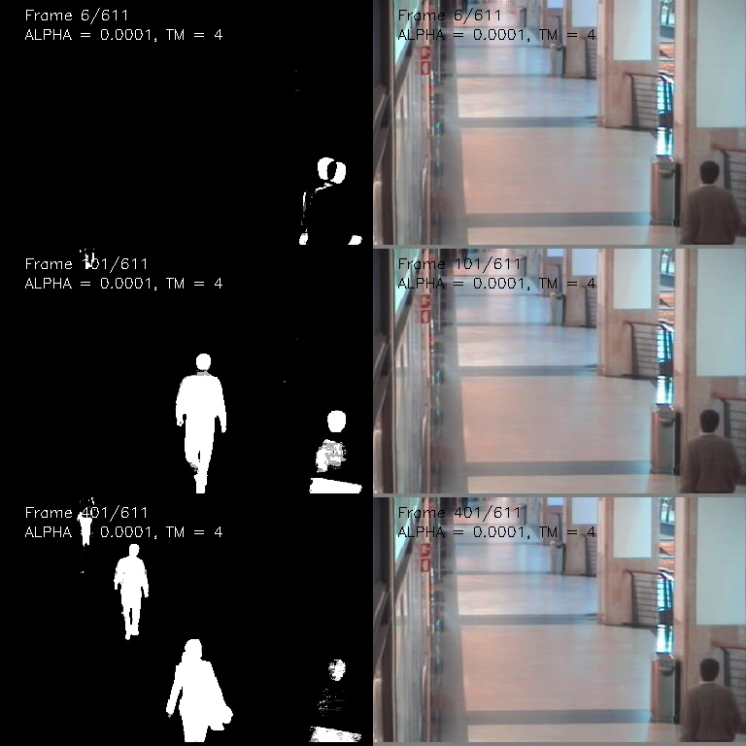
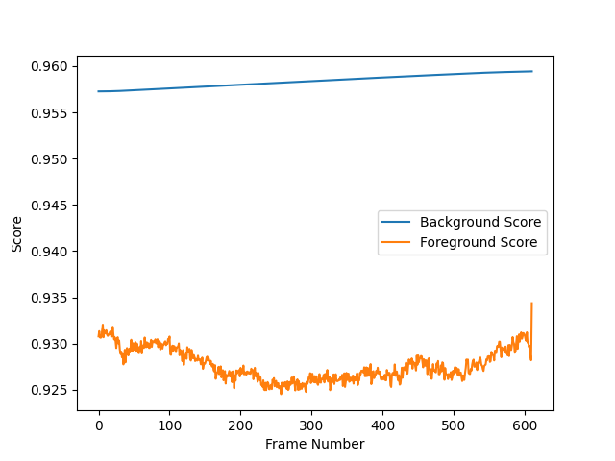
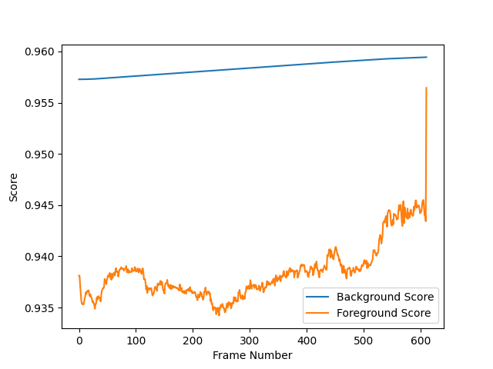
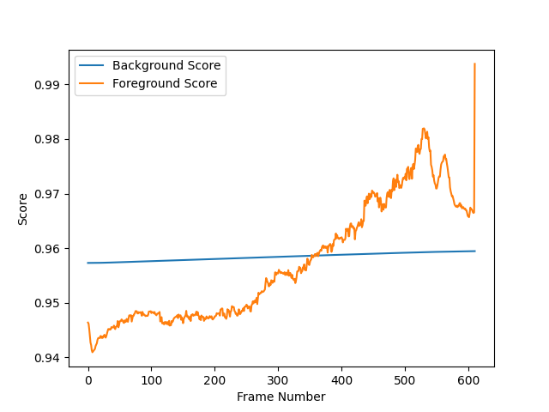
Results 5. Alpha = 0.0001
Alpha = 0.0001
TM = 2
Alpha = 0.0001
TM = 3
Alpha = 0.0001
TM = 4

Slide 9
Results Interpretation & Discussion
In this implementation of a simple background subtraction algorithm for detecting moving objects using a stationary camera, different learning rates (alpha) and matching thresholds (tm) are tested to observe their impact on the algorithm's performance. The chosen values are:
ALPHA_list = [0.01, 0.003, 0.001, 0.0003, 0.0001]
TM_list = [2, 3, 4]
Learning Rate (alpha):
The learning rate (alpha) determines how quickly the background model adapts to changes in the scene. A higher alpha value means the model will update faster and be more sensitive to rapid changes in the scene, whereas a lower alpha value will cause the model to update slowly, being less sensitive to scene changes.
From the experiments conducted with various alpha values, it can be observed that:
A high alpha (e.g., 0.01) results in a more adaptive model that quickly reacts to changes in the scene. This can lead to better detection of moving objects in dynamic environments. However, this can also result in false detections due to noise or small variations in lighting and other scene factors.
A low alpha (e.g., 0.0001) leads to a more stable background model that is less prone to false detections due to noise. However, the model will be slower to adapt to actual changes in the scene, possibly resulting in poor object detection when the scene is dynamic or when objects are moving slowly.
Matching Threshold (TM):
The matching threshold (TM) is used to determine whether a pixel belongs to the background or foreground based on the difference between its current value and the background model. A higher threshold means that a pixel must have a larger difference from the background model to be considered foreground, and a lower threshold makes the classification more sensitive to smaller differences.
From the experiments conducted with various TM values, it can be observed that:
A low TM (e.g., 2) results in more sensitivity to differences between the current frame and the background model, potentially detecting more foreground objects. However, this increased sensitivity can lead to more false detections due to noise or small variations in the scene.
A high TM (e.g., 4) reduces the sensitivity to differences between the current frame and the background model, potentially reducing false detections. However, this can also result in missed detections of actual moving objects if their differences from the background model are subtle.
In conclusion, the choice of learning rate (alpha) and matching threshold (TM) significantly impacts the performance of the background subtraction algorithm. The optimal values for these parameters depend on the specific application and the nature of the scene being analyzed. Tuning these parameters for the specific use case can improve the accuracy and robustness of the algorithm in detecting moving objects.

